Slide 1
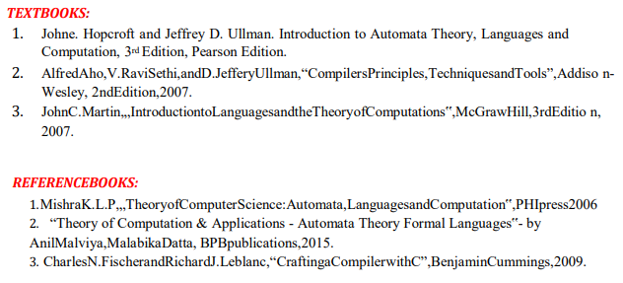

Slide 2
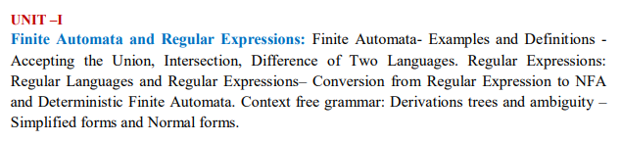

Slide 3
FINITE AUTOMATA
Finite automata are used to recognize patterns.
It takes the string of symbol as input and changes its state accordingly. When the desired symbol is found, then the transition occurs.
At the time of transition, the automata can either move to the next state or stay in the same state.
Finite automata have two states, Accept state or Reject state. When the input string is processed successfully, and the automata reached its final state, then it will accept.

Slide 4
A finite automaton is a collection of 5-tuple (Q, ∑, δ, q0, F), where:
Q: finite set of states
∑: finite set of the input symbol
q0: initial state
F: final state
δ: Transition function

Slide 5
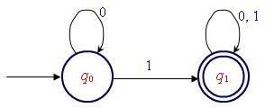
Q: finite set of states = q0,q1
∑: finite set of the input symbol = 0,1
q0: initial state = q0
F: final state = q1
δ: Transition function = δ(q0,0)→ q0,
δ(q0,1)→ q1,
δ(q1,0)→ q1,
δ(q1,1)→ q1

Slide 6
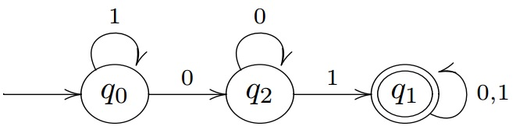
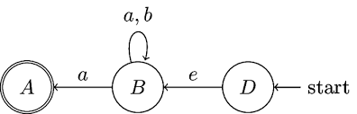
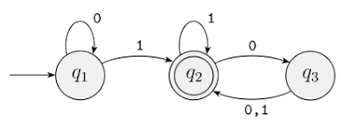

Slide 7
Finite Automata Representation
The finite automata can be represented in three ways, as given below −
Graphical (Transition diagram)
Tabular (Transition table)
Mathematical (Transition function)

Slide 8
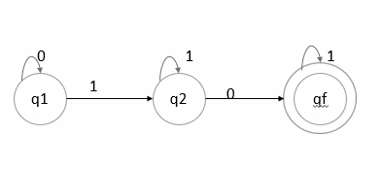
Transition Diagram
It is a directed graph associated with the vertices of the graph corresponding to the state of finite automata.
Here,
{0,1}: Inputs
q1: Initial state
q2: Intermediate state
qf: Final state

Slide 9
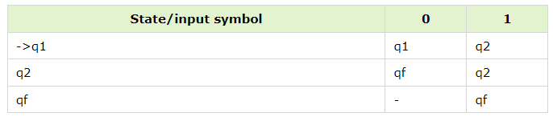
Transition table
It is basically a tabular representation of the transition function that takes two arguments (a state & a symbol) and returns a value (the ‘next state’).

Slide 10
Transition function
The transition function is denoted by δ.
The transition function returns a state which can be called as the next state.
δ (current_state, current_input_symbol) = next_state
Example:
δ(q0,a)=q1

Slide 11
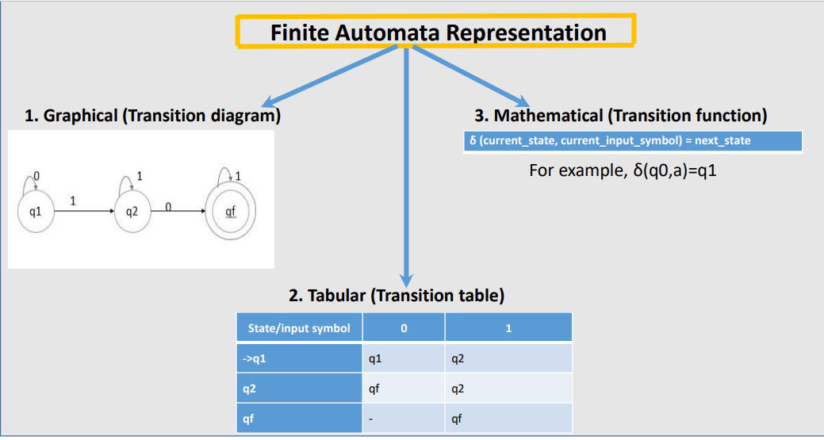

Slide 12
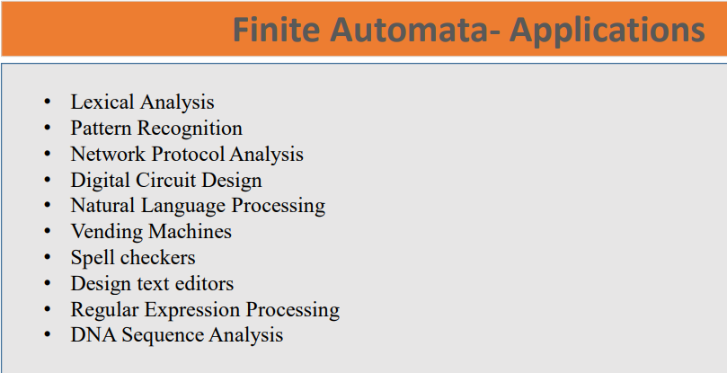

Slide 13
Finite Automata Model:
Finite automata can be represented by input tape and finite control.
Input tape: It is a linear tape having some number of cells. Each input symbol is placed in each cell.
Finite control: The finite control decides the next state on receiving particular input from input tape. The tape reader reads the cells one by one from left to right, and at a time only one input symbol is read.

Slide 14
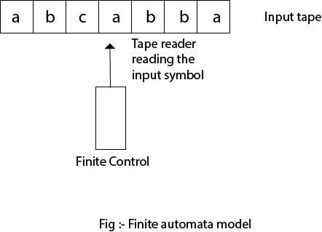

Slide 15
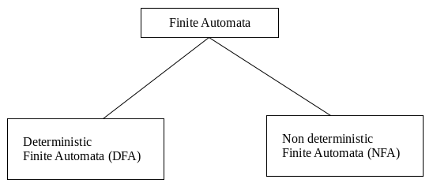
Types of Automata:
There are two types of finite automata:
DFA(deterministic finite automata)
NFA(non-deterministic finite automata)

Slide 16
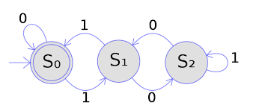
1. DFA
DFA refers to deterministic finite automata. Deterministic refers to the uniqueness of the computation.
In the DFA, the machine goes to one state only for a particular input character.
DFA does not accept the null move.

Slide 17
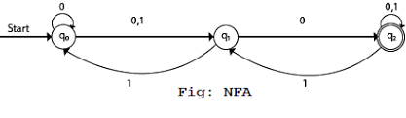
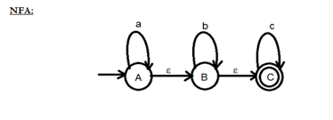
2. NFA
NFA stands for non-deterministic finite automata.
It is used to transmit any number of states for a particular input. It can accept the null move.

Slide 18
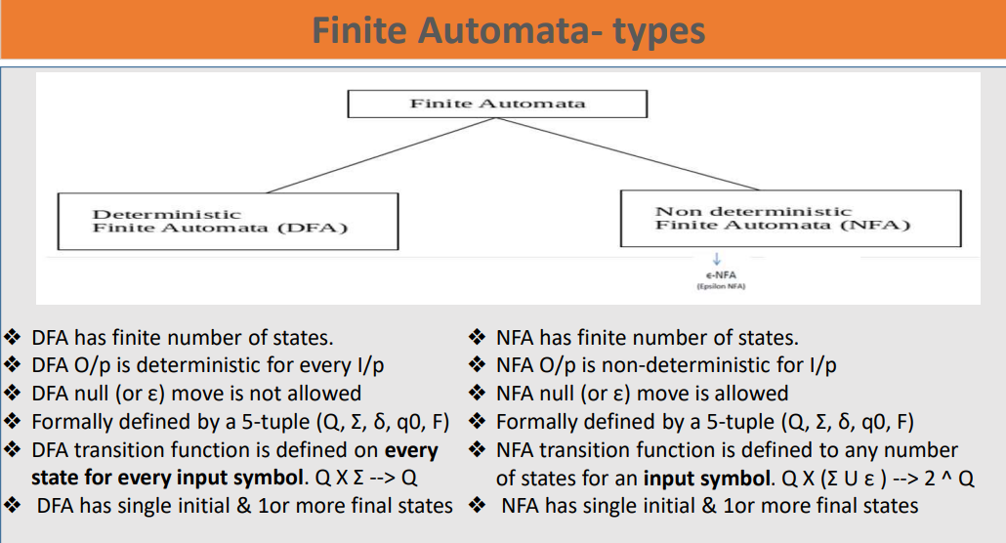

Slide 19
Some important points about DFA and NFA:
Every DFA is NFA, but NFA is not DFA.
There can be multiple final states in both NFA and DFA.
DFA is used in Lexical Analysis in Compiler.
NFA is more of a theoretical concept.

Slide 20

Practice problems on finite automata:
Example 1:
Design a FA with ∑ = {0, 1} accepts those string which starts with 1 and ends with 0.
Solution:
The FA will have a start state q0 from which only the edge with input 1 will go to the next state.

Slide 21

Example 2:
Design a FA with ∑ = {0, 1} accepts the only input 101.
Solution:
In the given solution, we can see that only input 101 will be accepted. Hence, for input 101, there is no other path shown for other input.

Slide 22

Example 3:
Design FA with ∑ = {0, 1} accepts the set of all strings with three consecutive 0's.
Solution:
The strings that will be generated for this particular languages are 000, 0001, 1000, 10001, .... in which 0 always appears in a clump of 3. The transition graph is as follows:
Note that the sequence of triple zeros is maintained to reach the final state.

Slide 23
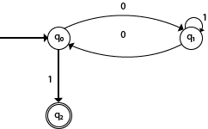
Example 4:
Design a FA with ∑ = {0, 1} accepts the strings with an even number of 0's followed by single 1.
Solution:

Slide 24
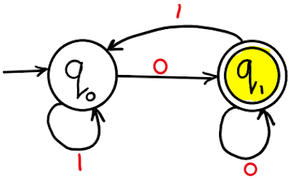
Practice problems on DFA:
Example 1:
Draw a DFA for the language accepting strings ending with ‘0’ over input alphabets ∑={0, 1} ?
Solution:

Slide 25
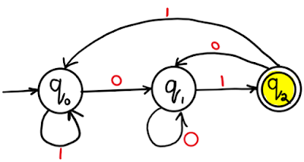
Example 2:
Draw a DFA for the language accepting strings ending with ‘01’ over input alphabets ∑={0, 1} ?
Solution:

Slide 26
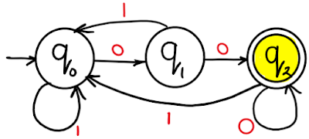
Example 3:
Draw a DFA for the language accepting strings ending with ‘00’ over input alphabets ∑={0, 1} ?
Solution:

Slide 27
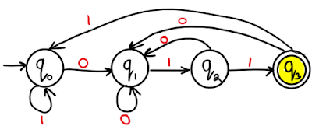
Example 4:
Draw a DFA for the language accepting strings ending with ‘011’ over input alphabets ∑ = {0, 1} ?
Solution:

Slide 28
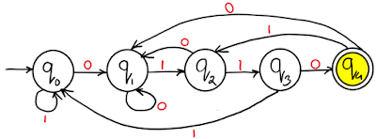
Example 5:
Draw a DFA for the language accepting strings ending with ‘0110’ over input alphabets ∑ = {0, 1} ?
Solution:

Slide 29
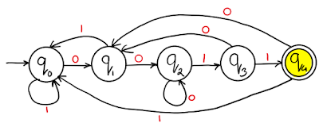
Example 6:
Draw a DFA for the language accepting strings ending with ‘0011’ over input alphabets ∑ = {0, 1} ?
Solution:

Slide 30
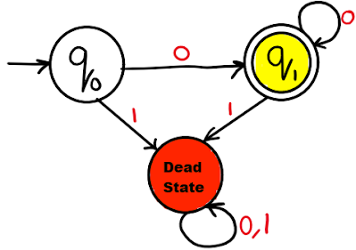
Example 7:
Draw a DFA for the language accepting strings with ‘0’ only over input alphabets ∑={0, 1} ?
Solution:

Slide 31
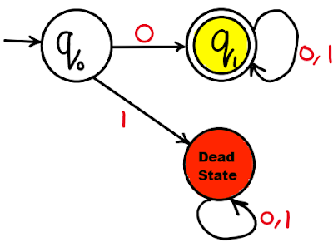
Example 8:
Draw a DFA for the language accepting strings starting with ‘0’ over input alphabets ∑={0, 1} ?
Solution:

Slide 32
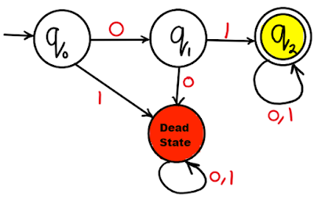
Example 9:
Draw a DFA for the language accepting strings starting with ‘01’ over input alphabets ∑={0, 1} ?
Solution:

Slide 33
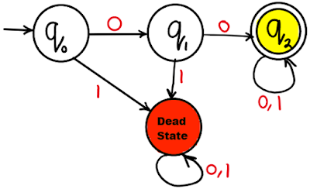
Example 10:
Draw a DFA for the language accepting strings starting with ‘00’ over input alphabets ∑={0, 1} ?
Solution:

Slide 34

Practice problems on NFA:
Example 1:
Design an NFA with ∑ = {0, 1} accepts all string ending with 01.
Solution:

Slide 35
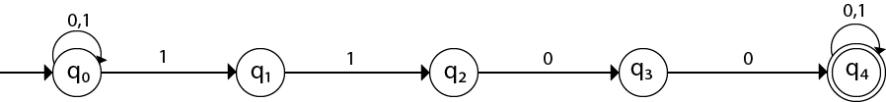
Example 2:
Design an NFA with ∑ = {0, 1} in which double '1' is followed by double '0'.
Solution:

Slide 36
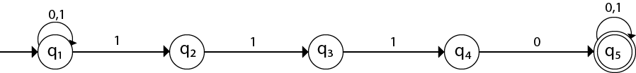
Example 3:
Design an NFA in which all the string contain a substring 1110.
Solution:

Slide 37
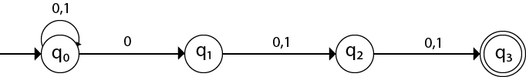
Example 4:
Design an NFA with ∑ = {0, 1} accepts all string in which the third symbol from the right end is always 0.
Solution:

Slide 38
Accepting the Union
To perform the union operation on two deterministic finite automata (DFAs), the following steps can be taken:
Create a new DFA with a new set of states, consisting of all the states from both original DFAs.
Define the initial state of the new DFA to be the tuple (q1, q2), where q1 and q2 are the initial states of the original DFAs.
For each state in the new DFA, define the transition function by taking the union of the transition functions of the original DFAs. For example, if the transition function for the first DFA is δ1(q1, a) = q2, and the transition function for the second DFA is δ2(q3, a) = q4, then the transition function for the new DFA is δ( (q1,q3), a ) = (q2,q4).
Define the set of final states of the new DFA to be the union of the sets of final states of the original DFAs.
The resulting DFA will recognize the language that is the union of the languages recognized by the original DFAs.

Slide 39
Example:
Designing a DFA for the set of string over {a, b} such that the string of the language start and end with different symbols.
Solution:
L₁ = {ab, aab, aabab, .......} L₂ = {ba, bba, bbaba, .......}
L₁= {starts with a and ends with b } and
L₂= {starts with b and ends with a}.
Then L= L₁ ∪ L₂ or
L= L₁ + L₂

Slide 40
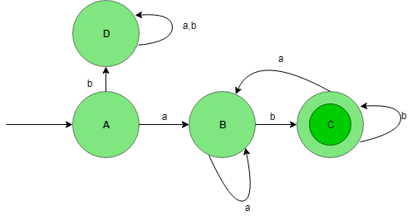

State Transition Diagram for the language L₁:
State Transition Diagram for the language L₂:

Slide 41
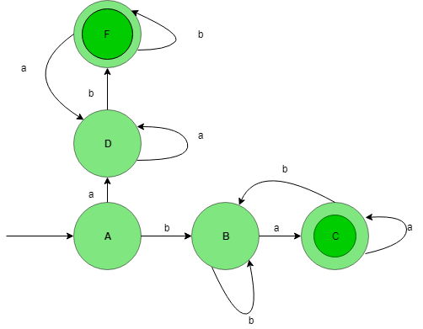
State Transition Diagram of L₁ ∪ L₂:

Slide 42
Accepting the Intersection
Example:
Designing a DFA for the set of string over {0, 1} such that it ends with 01 and has even number of 1’s.
Solution:
L₁= {01, 001, 101, 0101, 1001, 1101, ....} L₂= {11, 011, 101, 110, 0011, 1100, .....}
Then
L = L₁ and L₂ or
L = L₁ ∩ L₂

Slide 43
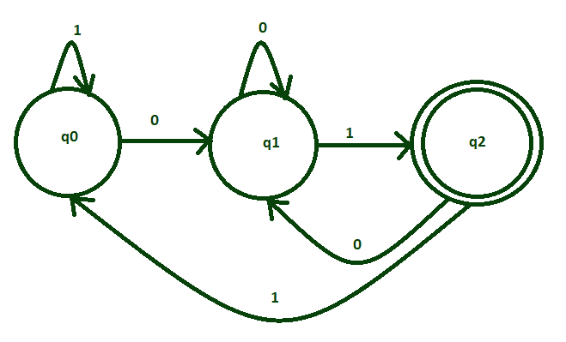
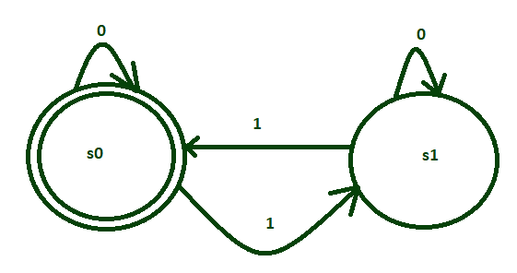
State Transition Diagram for the language L₁ :
State Transition Diagram for the language L₂ :

Slide 44
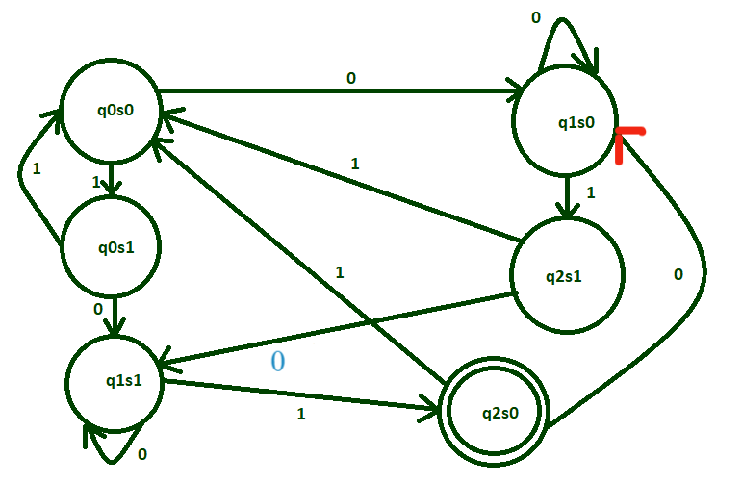
State Transition Diagram of L₁ ∩ L₂ :
Intersection of L₁ and L₂ can be explained by language that a string over {0, 1} accept such that it ends with 01 and has even number of 1’s.
L = L₁ ∩ L₂ = {1001, 0101, 01001, 10001, ....}

Slide 45
Conversion from NFA to DFA
An NFA can have zero, one or more than one move from a given state on a given input symbol. An NFA can also have NULL moves (moves without input symbol).
On the other hand, DFA has one and only one move from a given state on a given input symbol.
Steps for converting NFA to DFA:
Step 1: Convert the given NFA to its equivalent transition table
Step 2: Create the DFA’s start state
Step 3: Create the DFA’s transition table
Step 4: Create the DFA’s final states
Step 5: Simplify the DFA
Step 6: Repeat steps 3-5 until no further simplification is possible

Slide 46
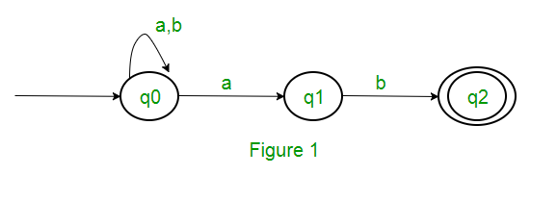
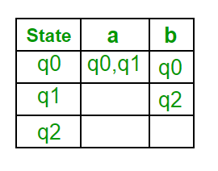
Example 1: Consider the following NFA and convert into DFA
Solution:
Following are the various parameters for NFA.
Step 1:
Convert the given NFA to its equivalent transition table

Slide 47
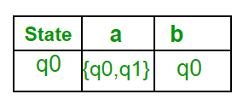
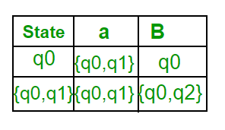
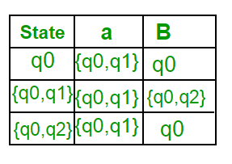
Step 2:
Create the DFA’s start state
Now { q0, q1 } will be considered as a single state.
Step 3: Create the DFA’s transition table
Now { q0, q2 } will be considered as a single state.
As there is no new state generated, we are done with the conversion.

Slide 48
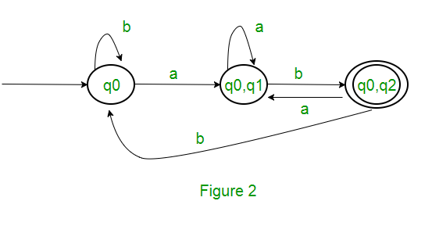
Step 4: Create the DFA’s final states
Final state of DFA will be state which has q2 as its component i.e., { q0, q2 } Following are the various parameters for DFA.
Step 5: Simplify the DFA
Note : Sometimes, it is not easy to convert regular expression to DFA. First you can convert regular expression to NFA and then NFA to DFA.

Slide 49
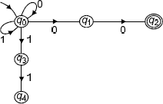
Example 2: Consider the following NFA to DFA or Find the equivalence of DFA from the following NFA

Slide 50
Convert NFA with epsilon to NFA without epsilon
Step 1 − Find out all the ε-transitions from each state
Step 2 − Then, determine 𝛿1 transitions. The 𝛿1 transitions means an ε-closure on 𝛿 moves.
Step 3 − Step 2 is repeated for each input symbol and for each state of given NFA
Step 4 − Construct NFA without epsilon

Slide 51
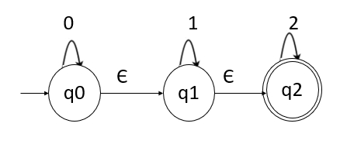
Example 1:
Convert the given NFA with epsilon to NFA without epsilon.
Solution:
Step 1 − Find out all the ε-transitions from each state
We will first obtain ε-closure of each state i.e., we will find ε-reachable states from the current state.
Hence,
ε-closure(q0) = {q0,q1,q2}
ε-closure(q1) = {q1,q2}
ε-closure(q2) = {q2}

Slide 52
Step 2 − Then, determine 𝛿’ transitions. The 𝛿1 transitions means an ε-closure on 𝛿 moves.
Now we will obtain 𝛿’ transitions for each state on each input symbol
δ'(q0, 0) = ε-closure(δ(ε-closure(q0, ε),0))
= ε-closure(δ(ε-closure(q0),0))
= ε-closure(δ(q0,q1,q2), 0))
= ε-closure(δ(q0, 0) ∪ δ(q1, 0) U δ(q2, 0) )
= ε-closure(q0 U Φ ∪ Φ)
= ε-closure(q0) = {q0,q1, q2}
δ'(q0, 1) = ε-closure(δ(ε-closure(q0, ε),1))
= ε-closure(δ(q0,q1,q2), 1))
= ε-closure(δ(q0, 1) ∪ δ(q1, 1) U δ(q2, 1) )
= ε-closure(Φ ∪q1 U Φ)
= ε-closure(q1) = {q1, q2}

Slide 53
δ'(q0, 2) = ε-closure(δ(ε-closure(q0, ε),2))
= ε-closure(δ(q0,q1,q2), 2))
= ε-closure(δ(q0, 2) ∪ δ(q1, 2) U δ(q2, 2) )
= ε-closure(Φ U ΦU q2)
= ε-closure(q2) = {q2}
δ'(q1, 0) = ε-closure(δ(ε-closure(q1, ε),0))
= ε-closure(δ(q1,q2), 0))
= ε-closure(δ(q1, 0) U δ(q2, 0) )
= ε-closure(Φ ∪ Φ)
= ε-closure(Φ)
= Φ
δ'(q1,1) = ε-closure(δ(δ^(q1, ε),1))
= ε-closure(δ(q1,q2), 1))
= ε-closure(δ(q1, 1) U δ(q2, 1) )
= ε-closure(q1 ∪ Φ)
= ε-closure(q1)
= {q1,q2}

Slide 54
δ'(q1, 2) = ε-closure(δ(ε-closure(q1, ε),2))
= ε-closure(δ(q1,q2), 2))
= ε-closure(δ(q1, 2) U δ(q2, 2) )
= ε-closure(Φ ∪ q2)
= ε-closure(q2)
= {q2}
δ'(q2, 0) = ε-closure(δ(ε-closure(q2, ε),0))
= ε-closure(δ(q2), 0))
= ε-closure(δ(q2, 0))
= ε-closure(Φ)
= Φ
δ'(q2, 1) = ε-closure(δ(ε-closure(q2, ε),1))
= ε-closure(δ(q2), 1)
= ε-closure(δ(q2, 1))
= ε-closure(Φ)
= Φ

Slide 55
δ'(q2, 2) = ε-closure(δ(ε-closure(q2, ε),2))
= ε-closure(δ(q2), 2))
= ε-closure(δ(q2, 2))
= ε-closure(q2)
= {q2}
Now, we will summarize all the computed δ' transitions as given below −
δ'(q0,0)={q0,q1,q2}
δ'(q0,1)={q1,q2}
δ'(q0,2)={q2}
δ'(q1,0)= { Φ }
δ'(q1,1)={q1,q2}
δ'(q1,2)={q2}
δ'(q2,0)={ Φ }
δ'(q2,1)={ Φ }
δ'(q2,2)={q2}

Slide 56
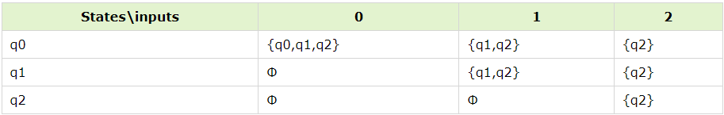
Step 4 − Construct NFA without epsilon

Slide 57
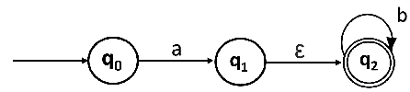
Example 2:
Convert the given NFA with epsilon to NFA without epsilon.
δ'(q0, a) = {q1, q2}
δ'(q0, b) = Ф
δ'(q1, a) = Ф
δ'(q1, b) = {q2}
δ'(q2, a) = Ф
δ'(q2, b) = {q2}
ε-closure(q0) = {q0}
ε-closure(q1) = {q1, q2}
ε-closure(q2) = {q2}

Slide 58
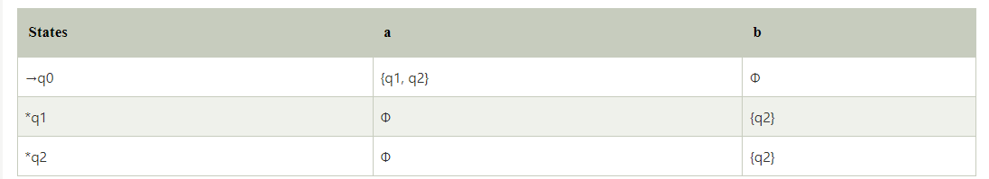

Slide 59
Regular Expression
The language accepted by finite automata can be easily described by simple expressions called Regular Expressions. It is the most effective way to represent any language.
The languages accepted by some regular expression are referred to as Regular languages.
A regular expression can also be described as a sequence of pattern that defines a string.
Regular expressions are used to match character combinations in strings.
String searching algorithm used this pattern to find the operations on a string.

Slide 60
In a regular expression, x* means zero or more occurrence of x. It can generate {e, x, xx, xxx, xxxx, .....}
In a regular expression, x⁺ means one or more occurrence of x. It can generate {x, xx, xxx, xxxx, .....}
Operations on Regular Language:
The various operations on regular language are:
Union: If L1 and L2 are two regular languages then their union L1 U L2 is also a union.
L1 U L2 = {s | s is in L1 or s is in L2}
Intersection: If L1 and L2 are two regular languages then L1 ⋂ L2 is also an intersection.
L1 ⋂ L2 = {st | s is in L1 and t is in L2}
Kleen closure: If L is a regular language then its Kleen closure L1* will also be a regular language.
L* = Zero or more occurrence of language L

Slide 61
Example 1:
Write the regular expression for the language accepting all combinations of a's, over the set ∑ = {a}
Solution:
All combinations of a's means a may be zero, single, double and so on.
If a is appearing zero times, that means a null string.
That is we expect the set of {ε, a, aa, aaa, ....}. So we give a regular expression for this as:
R.E: a*
That is Kleen closure of a.

Slide 62
Example 2:
Write the regular expression for the language accepting all combinations of a's except the null string, over the set ∑ = {a}
Solution:
The regular expression has to be built for the language:
L = {a, aa, aaa, ....}
This set indicates that there is no null string. So we can denote regular expression as:
R.E: a⁺

Slide 63
Example 3:
Write the regular expression for the language accepting all the string containing any number of a's and b's.
Solution:
The regular expression will be:
R.E: (a + b)*
This will give the set as L = {ε, a, aa, b, bb, ab, ba, aba, bab, .....}, any combination of a and b.
The (a + b)* shows any combination with a and b even a null string.

Slide 64
Example 4:
Write the regular expression for the language accepting all the string which are starting with 1 and ending with 0, over ∑ = {0, 1}.
Solution:
In a regular expression, the first symbol should be 1, and the last symbol should be 0. The r.e. is as follows:
R.E: 1 (0+1)* 0
Example 5:
Write the regular expression for the language starting and ending with a and having any combination of b's in between.
Solution:
The regular expression will be:
R.E: a b* a

Slide 65
Example 6:
Write the regular expression for the language starting with a but not having consecutive b's.
Solution:
The regular expression has to be built for the language:
L = {a, aba, aab, aba, aaa, abab, .....}
The regular expression for the above language is:
R.E: a + (aba)*

Slide 66
Example 7:
Write the regular expression for the language accepting all the string in which any number of a's is followed by any number of b's is followed by any number of c's.
Solution:
Any number of a's means a* any number of b's means b*, any number of c's means c*. Since as given in problem statement, b's appear after a's and c's appear after b's. So the regular expression could be:
R.E: a* b* c*

Slide 67
Example 8:
Write the regular expression for the language over ∑ = {0} having even length of the string.
Solution:
The regular expression has to be built for the language:
L = {ε, 00, 0000, 000000, ......}
The regular expression for the above language is:
R = (00)*

Slide 68
Example 9:
Describe the language denoted by following regular expression
r.e. = (b* (aaa)* b*)*
Solution:
The language can be predicted from the regular expression by finding the meaning of it. We will first split the regular expression as:
r.e. = (any combination of b's) (aaa)* (any combination of b's)
L = {The language consists of the string in which a's appear triples, there is no restriction on the number of b's}

Slide 69
Example 10:
Write the regular expression for the language L over ∑ = {0, 1} such that all the string do not contain the substring 01.
Solution:
The Language is as follows:
L = {ε, 0, 1, 00, 11, 10, 100, .....}
The regular expression for the above language is as follows:
R = (1* 0*)

Slide 70

Conversion of RE to NFA
Algorithm for the conversion of Regular Expression to NFA
Input − A Regular Expression R
Output − NFA accepting language denoted by R
For ε, NFA is

Slide 71

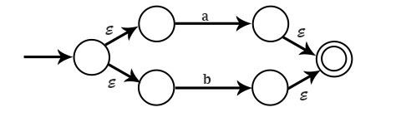
For a, NFA is
For a + b, NFA is

Slide 72

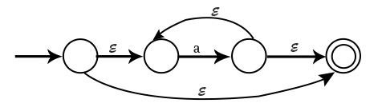
For ab, NFA is
For a*, NFA is

Slide 73
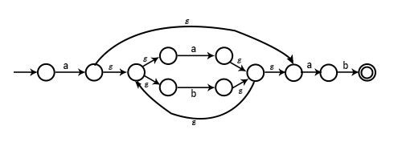
Example1 − Draw NFA for the Regular Expression
a(a+b)*ab
Solution

Slide 74
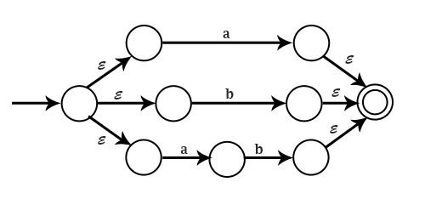
Example2 − Draw NFA for a + b + ab
Solution

Slide 75

Example3 − Draw NFA for letter (letter+digit)*
Solution

Slide 76

Example4 − Draw NFA corresponding to (0+1)*1(0+1)
Solution

Slide 77
Conversion of RE to DFA
To convert the regular expression (RE) to Deterministic Finite Automata (FA), we can use the Subset method.
Subset method is used to obtain DFA from the given RE.
Step1 − Construct a Transition diagram for a given RE by using Non-deterministic finite automata (NFA) with ε moves.
Step2 − Convert NFA with ε to NFA without ε.
Step3 − Convert the NFA to the equivalent Deterministic Finite Automata (DFA).

Slide 78


Example 1:
Design DFA from given RE 10 + (0 + 11)0* 1.
Solution:
First we will construct the transition diagram for a given regular expression.
Step 1:
Step 2:

Slide 79


Step 3:
Step 4:

Slide 80


Step 5:

Slide 81


The equivalent DFA will be:

Slide 82
CONTEXT FREE GRAMMAR
Context free grammar is a formal grammar which is used to generate all possible strings in a given formal language.
Context free grammar G can be defined by four tuples as:
G= (V, T, P, S)
Where,
G describes the grammar
V describes a finite set of non-terminal symbols
T describes a finite set of terminal symbols
P describes a set of production rules
S is the start symbol.

Slide 83
The grammar G=(V,T,P,S) is said to be a CFG if the productions of G are of the form:
Example:
S→aAB
S→ (a)
A→bBb
A→b.a
B->A
B-> ε
V =set of non-terminals= S,A,B
T =set of terminals=a,b,ε,(,),.
P=set of production rules=S->Aab | (a), A->bBb | b.a, B->A, B-> ε
S=start symbol=S

Slide 84
Example1: What is the language generated by the grammar
S->aSb S->ab
Solution:
S->aSb // S->aSb
->aaSbb // S->aSb
->aaaSbbb // S->ab
->aaaabbbb

Slide 85
Example2:
Construct a CFG for the language
where n>=1.
Solution:
The string that can be generated for a given language is {abb, aabbbb, aaabbbbbb....}. The grammar could be:
S →abb
S → aSbb
Therefore the CFG can be constructed as G=(V,T,P,S)
Where V={S}
T={a,b}
P=S → aSbb | abb
S={S}

Slide 86
Example3: What is the language generated by the grammar Let G=(V,T,P,S) where V={S,C} , T={a,b}
P={ S->0A | ε
A->1S }
S->0A //A->1S
-> 01S //S->0A
->010A // A->1S
->0101S //S->ε
->0101
Solution:

Slide 87
Derivation
Derivation is a sequence of production rules.
It is used to get the input string through these production rules.
During parsing we have to take two decisions. These are as follows:
We have to decide the non-terminal which is to be replaced.
We have to decide the production rule by which the non-terminal will be replaced.

Slide 88
We have two options to decide which non-terminal to be replaced with production rule.
Left-most Derivation
In the left most derivation, the input is scanned and replaced with the production rule from left to right. So in left most derivatives we read the input string from left to right.
Right-most Derivation
In the right most derivation, the input is scanned and replaced with the production rule from right to left. So in right most derivatives we read the input string from right to left.

Slide 89


Slide 90
Example:
Derive the string w=abab using LMD,RMD from the following grammar.
S → AA
A → aB
B → b
B → ε
Solution:
Leftmost Derivation
Rightmost Derivation
S ⇒ A A //A-> aB
⇒a B A //B->b
⇒a b A //A-> aB
⇒ a b a B //B->b
⇒ a b a b
S ⇒ A A //A-> aB
⇒ A a B //B->b
⇒A a b //A-> aB
⇒ a B a b //B->b
⇒a b a b

Slide 91
Example:
Derive the string w=id+id+id*id using LMD, RMD from the following grammar.
E → E+E| E * E | id
Solution:
Leftmost Derivation
Rightmost Derivation
E ⇒ E+E
⇒ id+E+E
⇒ id+id+E
⇒ id+id+E*E
⇒ id+id+id*E
⇒ id+id+id*id
E ⇒ E+E
⇒ E+ E*E
⇒ E+E*id
⇒ E+id*id
⇒ E+E+id*id
⇒ E+id+id*id
⇒ id+id+id*id

Slide 92
Example:
Consider the following grammar
S → aB / bA
A → aS / bAA / a
B → bS / aBB / b
Solution:
Let us consider a string w = aaabbabbba
Leftmost Derivation
S → aB
→ aaBB (Using B → aBB)
→ aaaBBB (Using B → aBB)
→ aaabBB (Using B → b)
→ aaabbB (Using B → b)
→ aaabbaBB (Using B → aBB)
→ aaabbabB (Using B → b)
→ aaabbabbS (Using B → bS)
→ aaabbabbbA (Using S → bA)
→ aaabbabbba (Using A → a)

Slide 93
Rightmost Derivation
S → aB
→ aaBB (Using B → aBB)
→ aaBaBB (Using B → aBB)
→ aaBaBbS (Using B → bS)
→ aaBaBbbA (Using S → bA)
→ aaBaBbba (Using A → a)
→ aaBabbba (Using B → b)
→ aaaBBabbba (Using B → aBB)
→ aaaBbabbba (Using B → b)
→ aaabbabbba (Using B → b)

Slide 94


Slide 95

Ambiguity
A grammar is said to ambiguous if for any string generated by it, it produces more than one-Parse tree Or derivation tree Or syntax tree Or leftmost derivation Or rightmost derivation
Example: X → X+X | X*X |X| a

Slide 96


Example:
S = aSb | SS
S = ∈
For the string aabb, the above grammar generates two parse trees:

Slide 97
Simplified Forms
All the grammar are not always optimized that means the grammar may consist of some extra symbols(non-terminal).
Having extra symbols, unnecessary increase the length of grammar.
Simplification of grammar means reduction of grammar by removing useless symbols.

Slide 98


Slide 99
Properties of Reduced Grammar
Each variable (i.e. non-terminal) and each terminal of G appears in the derivation of some word in L.
There should not be any production as X → Y where X and Y are non-terminal.
If ε is not in the language L then there need not to be the production X → ε.

Slide 100
Removal of Useless Symbols
A symbol can be useless if it does not appear on the right-hand side of the production rule and does not take part in the derivation of any string.
Example: T → aaB | aaT
A → aA
B → ab | b
C → ad
A → aA //useless because there is no way to terminate A
C → ad // useless the variable 'C' will never occur in the derivation of any string

Slide 101
After reduction:
T → aaB | aaT
B → ab | b
Elimination of ε Production
The productions of type S → ε are called ε productions.
These type of productions can only be removed from those grammars that do not generate ε

Slide 102
Step 1: First find out all nullable non-terminal variable which derives ε.
Step 2: For each production A → ε, replace each occurrence of A with ε
Step 3: Now combine the result of step 2 with the original production and remove ε productions.
EXAMPLE: 1. S → XYX 2. X → 0X | ε 3. Y → 1Y | ε
Here nullable non-terminals are X & Y

Slide 103
Let us take 1st production rule replace X with ε
a)S → XYX
b)S → YX //If the first X at RHS is ε.
c)S → XY //If the last X at RHS is ε.
d)S → Y // If both X are replaced by ε
Now replace Y with ε on above rules a,b,c,d
S → XX // If Y = ε on rule (a)
S → X // If Y = ε on rule (b) / (c)
Now, after ε elimination on (1)S → XYX
S → XYX | XY | YX | Y | XX | X ---------------1

Slide 104
Let us take 2nd production rule
X → 0X | ε
X → 0 //If the X is ε Now,
after ε elimination on (2) X → 0X | ε
X → 0X | 0------------------------------------------2
Let us take 3rd production rule
Y → 1Y | ε
Y → 1 //If the Y is ε
Now, after ε elimination on (3) Y → 1Y | ε
Y → 1Y | 1--------------------------------------------3

Slide 105
After reduction:
S → XYX | XY | YX | Y| XX | X
X → 0X | 0
Y → 1Y | 1

Slide 106
Removing Unit Productions
The unit productions are the productions in which one non-terminal gives another non-terminal.
Use the following steps to remove unit production:
Step 1: To remove X → Y, add production X → a to the grammar rule whenever Y → a occurs in the grammar. Step 2: Now delete X → Y from the grammar.
Step 3: Repeat step 1 and step 2 until all unit productions are removed.

Slide 107
Example: S → 0A | 1B | C
A → 0S | 00
B → 1 | A
C → 01
Here S → C & B →A are unit productions
To remove C , add rules of C (i.e, C → 01 ) to S
Similarly to remove A, add rules of A (i.e, A → 0S | 00) to B
Thus finally we can write CFG without unit production as:
S → 0A | 1B | 01
A → 0S | 00
B → 1 | 0S | 00
C → 01

Slide 108

Recursion
A grammar is said to be recursive if it contains at least one production that has the same variable at both its LHS and RHS.

Slide 109
Removal of Left Recursion
A Grammar G (V, T, P, S) is left recursive if it has a production in the form.
A → A α |β
The above Grammar is left recursive because the left of production is occurring at a first position on the right side of production. It can eliminate left recursion by replacing a pair of production with
A → βA′
A’ → αA′|ϵ

Slide 110

Elimination of Left Recursion
Left Recursion can be eliminated by introducing new non-terminal A such that.

Slide 111
Example1 − Consider the Left Recursion from the Grammar.
E → E + T|T
T → T * F|F
F → (E)|id
Eliminate immediate left recursion from the Grammar.
Solution
Comparing E → E + T|T with A → A α |β
∴ A = E, α = +T, β = T
∴ A → A α |β is changed to A → βA′and A′ → α A′|ε
∴ A → βA′ means E → TE′
A′ → α A′|ε means E′ → +TE′|ε

Slide 112
Comparing T → T ∗ F|F with A → Aα|β
∴ A = T, α =∗ F, β = F
∴ A → β A′ means T → FT′
A’ → α A′|ε means T′ →* FT′|ε
Production F → (E)|id does not have any left recursion
∴ Combining productions we get
E → TE′
E′ → +TE′| ε
T → FT′
T’ →* FT′|ε
F → (E)| id

Slide 113

Normal Forms
Normalization is the process of standardizing the grammar rules of a certain language. It puts some restrictions on the grammar rules without changing the language.

Slide 114
Chomsky's Normal Form (CNF)
CNF stands for Chomsky normal form.
A CFG(context free grammar) is in CNF(Chomsky normal form) if all production rules satisfy one of the following conditions:
Start symbol generating ε.
For example, A → ε.
A non-terminal generating two non-terminals.
For example, S → AB.
A non-terminal generating a terminal.
For example, S → a.

Slide 115
Example:
G1 = {S → AB, S → c, A → a, B → b}
G2 = {S → aA, A → a, B → c}
The production rules of Grammar G1 satisfy the rules specified for CNF, so the grammar G1 is in CNF.
However, the production rule of Grammar G2 does not satisfy the rules specified for CNF as S → aZ contains terminal followed by non-terminal. So the grammar G2 is not in CNF.

Slide 116
Steps for converting CFG into CNF:
Step 1: Eliminate start symbol from the RHS. If the start symbol T is at the right-hand side of any production, create a new production as:
S1 → S
Where S1 is the new start symbol.
Step 2: In the grammar, remove the null, unit and useless productions.
Step 3: Eliminate terminals from the RHS of the production if they exist with other non-terminals or terminals. For example, production S → aA can be decomposed as:
S → RA
R → a

Slide 117
Step 4: Eliminate RHS with more than two non-terminals.
For example, S → ASB can be decomposed as:
S → RS
R → AS
Example:
Convert the given CFG to CNF. Consider the given grammar G1:
S → a | aA | B
A → aBB | ε
B → Aa | b
Solution:
Step 1: We will create a new production S1 → S, as the start symbol S appears on the RHS. The grammar will be:
S1 → S
S → a | aA | B
A → aBB | ε
B → Aa | b

Slide 118
Step 2: As grammar G1 contains A → ε null production, its removal from the grammar yields:
S1 → S
S → a | aA | B
A → aBB
B → Aa | b | a
Now, as grammar G1 contains Unit production S → B, its removal yield:
S1 → S
S → a | aA | Aa | b
A → aBB
B → Aa | b | a
Also remove the unit production S1 → S, its removal from the grammar yields:
S0 → a | aA | Aa | b
S → a | aA | Aa | b
A → aBB
B → Aa | b | a

Slide 119
Step 3: In the production rule S0 → aA | Aa, S → aA | Aa, A → aBB and B → Aa, terminal a exists on RHS with non-terminals. So we will replace terminal a with X:
S0 → a | XA | AX | b
S → a | XA | AX | b
A → XBB
B → AX | b | a
X → a
Step 4: In the production rule A → XBB, RHS has more than two symbols, removing it from grammar yield:
S0 → a | XA | AX | b
S → a | XA | AX | b
A → RB
B → AX | b | a
X → a
R → XB
Hence, for the given grammar, this is the required CNF.

Slide 120
Greibach Normal Form (GNF)
GNF stands for Greibach normal form.
A CFG(context free grammar) is in GNF(Greibach normal form) if all the production rules satisfy one of the following conditions:
A start symbol generating ε. For example, S → ε.
A non-terminal generating a terminal. For example, A → a.
A non-terminal generating a terminal which is followed by any number of non-terminals. For example, S → aASB.

Slide 121
Example:
G1 = {S → aAB | aB, A → aA| a, B → bB | b}
G2 = {S → aAB | aB, A → aA | ε, B → bB | ε}
The production rules of Grammar G1 satisfy the rules specified for GNF, so the grammar G1 is in GNF.
However, the production rule of Grammar G2 does not satisfy the rules specified for GNF as A → ε and B → ε contains ε(only start symbol can generate ε). So the grammar G2 is not in GNF.
Steps for converting CFG into GNF:
Step 1: Convert the grammar into CNF.
Step 2: If the grammar exists left recursion, eliminate it.
Step 3: In the grammar, convert the given production rule into
GNF form.

Slide 122
Example:
Convert the given CFG to GNF.
S → XB | AA
A → a | SA
B → b
X → a
Solution:
As the given grammar G is already in CNF and there is no left recursion, so we can skip step 1 and step 2 and directly go to step 3.
The production rule A → SA is not in GNF, so we substitute S → XB | AA in the production rule A → SA as:
S → XB | AA
A → a | XBA | AAA
B → b
X → a

Slide 123
The production rule S → XB and B → XBA is not in GNF, so we substitute X → a in the production rule S → XB and B → XBA as:
S → aB | AA
A → a | aBA | AAA
B → b
X → a
Now we will remove left recursion (A → AAA), we get:
S → aB | AA
A → aC | aBAC
C → AAC | ε
B → b
X → a

Slide 124
Now we will remove null production C → ε, we get:
S → aB | AA
A → aC | aBAC | a | aBA
C → AAC | AA
B → b
X → a
The production rule S → AA is not in GNF, so we substitute
A → aC | aBAC | a | aBA in production rule S → AA as:
S → aB | aCA | aBACA | aA | aBAA
A → aC | aBAC | a | aBA
C → AAC
C → aCA | aBACA | aA | aBAA
B → b
X → a

Slide 125
The production rule C → AAC is not in GNF, so we substitute
A → aC | aBAC | a | aBA in production rule C → AAC as:
S → aB | aCA | aBACA | aA | aBAA
A → aC | aBAC | a | aBA
C → aCAC | aBACAC | aAC | aBAAC
C → aCA | aBACA | aA | aBAA
B → b
X → a
Hence, this is the GNF form for the grammar G.

